Slide 1
Let’s Recap! Count on in your heads to find the answers- write them on your whiteboard.
56 + 3 = 164 + 3 =
72 + 5 = 282 + 6 =
42 + 4 = 313 + 4 =
86 + 5 = 575 + 8 =
63 + 9 = 427 + 5 =

Slide 2
Let’s Recap! Count on in your heads to find the answers- write them on your whiteboard.
56 + 3 = 59 164 + 3 = 167
72 + 5 = 77 282 + 6 = 288
42 + 4 = 46 313 + 4 = 317
86 + 5 = 91 575 + 8 = 583
63 + 9 = 72 427 + 5 = 432

Slide 3
11.11.20 L.G. To subtract a 3-digit number from a 3-digit number- no exchange

Slide 4
What type of calculation do we need to do here to find the answer?
Discuss and see if any children can have a go at working out the answer on their whiteboards.
Discuss the different methods used.

Slide 5
Today we are going to be subtracting two 3-digit numbers where there is no exchange.
Watch the following video up to 2mins 20secs:
https://www.youtube.com/watch?v=mKMluumuOmc

Slide 6
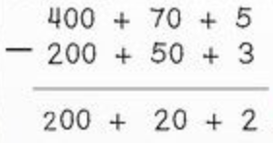
Here is an example of how to do your working out:
475 – 253 =

Slide 8
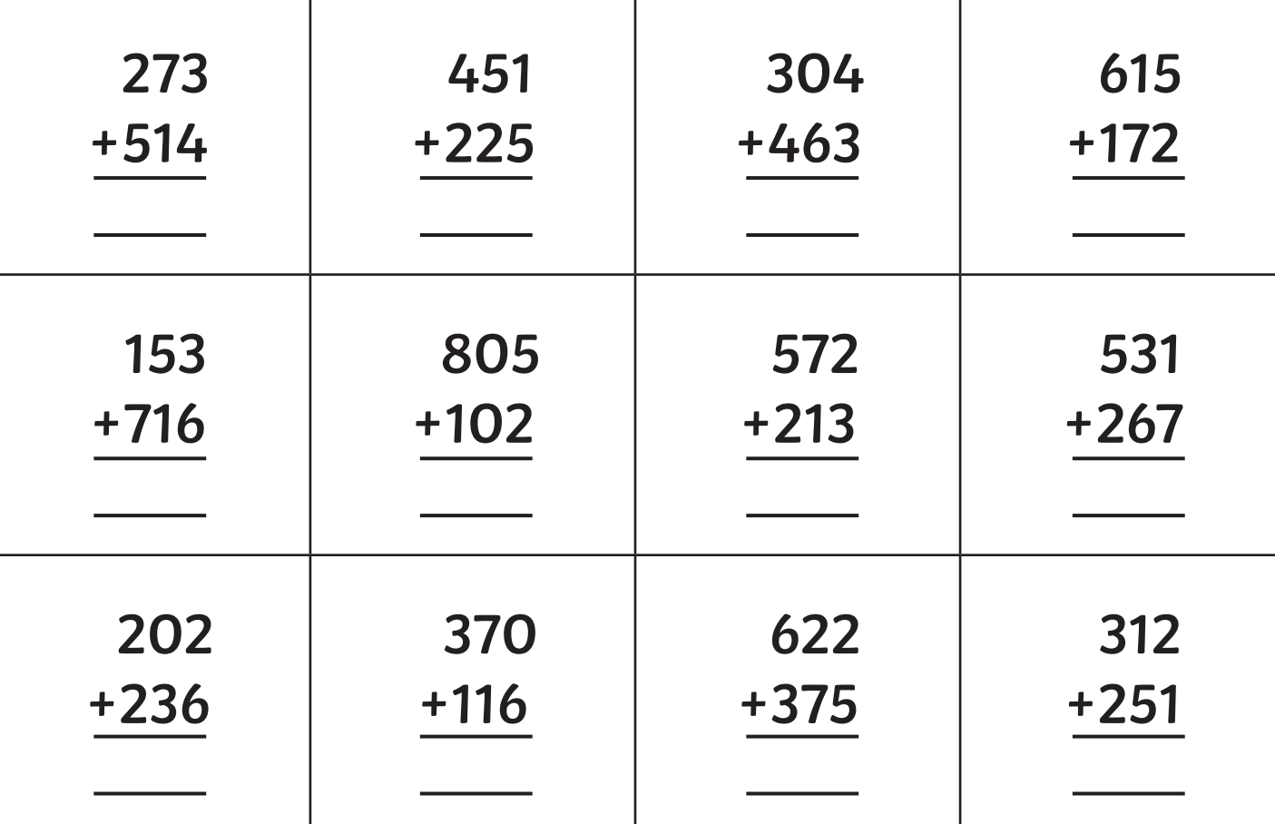
Have a go at completing these in your book:

Slide 9
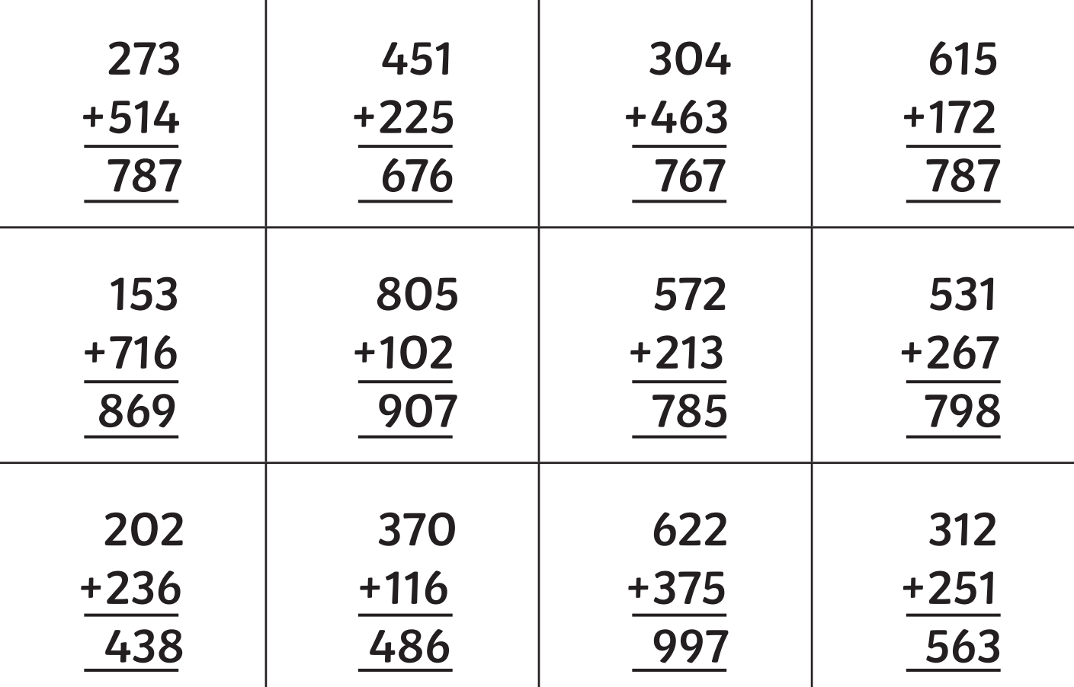
Check your answers:

